Slide 1
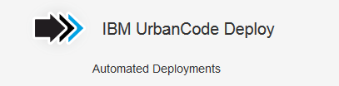

Slide 2
UrbanCode Deploy
IBM UrbanCode Deploy orchestrates and automates the deployment of applications, databases and configurations into development, test and production enviroments, helping to drive down cost and speed time to market with reduced risk.

Slide 3
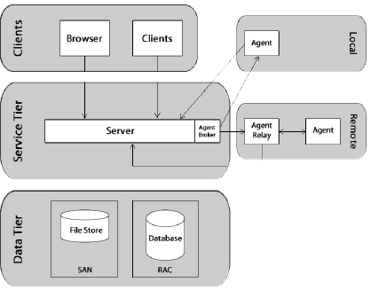
ARCHITECTURE

Slide 4
IBM uDeploy architecture consists of a service tier and a data tier.
The service tier has a central server that provides a web server front-end and core services, such as workflow, agent management, deployment, inventory, security, as well as others.
Most server-agent communication is done via JMS but HTTP(S) is also used as required.
Data Tier provides log file and Code Station artifact storage

Slide 5
Key Features
Multi-Tier Application Models
Easy Process Designer
Fully automated deployments through different application environments
Parallel Deployments
Full & Incremental Updates and Automated Rollbacks
Track What is Where: Inventory
Clear Visibility: Who changed what
Snapshots ensure that exact versions of components are deployed
Artifact Repository: Store deployment artifacts more securely to enable traceability
Scalable Distributed Automation
Quality Gates and Approvals
Integrations Replace Custom Scripting

Slide 6
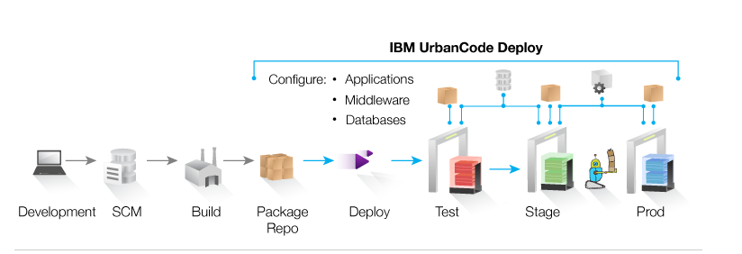
Typical Uses
Continuous Delivery: Integrate with build and test tools to automatically deploy, test and promote new builds
Production Deployments: Orchestrate a complex production deployments of applications and configuration
Self-Service: Grant different teams rights to “push the go button” for different applications and environments
Incremental Updates: Deploy only the changes components or missing incremental (patch) versions

Slide 7
Supporting Technologies
  Source Control: RTC, SVN, Git, ClearCase
  Application servers: JBoss, IIS, Tomcat, WebLogic
  Databases: MS SQL Server, Oracle SQL*Plus, JDB
  Change Management: RTC, ClearQuest, Jira, TFS
  Quality Assurance: HPQC, Selenium, Sonar
  Build: Ant, Maven

Slide 8
Terminology
Component: Deployable items/Artifacts(files, images, database configurations)
Component Process: Series of user-defined steps that operate on a component's artifacts
Application: Initiate component deployments; it brings together components with their deployment targets, and orchestrate multi-component deployments
Application Process: Sequence the Components when multiple components or multiple processes for a component exist
Code Station: Build artifact repository
Agent: Communication between server and workstation
Agent Pool: A set of agents can be used for some automated action
Environments: User-defined collection of resources that host an application
Resource: Deployment target--a physical machine, virtual machine, database, J2EE container

Slide 9
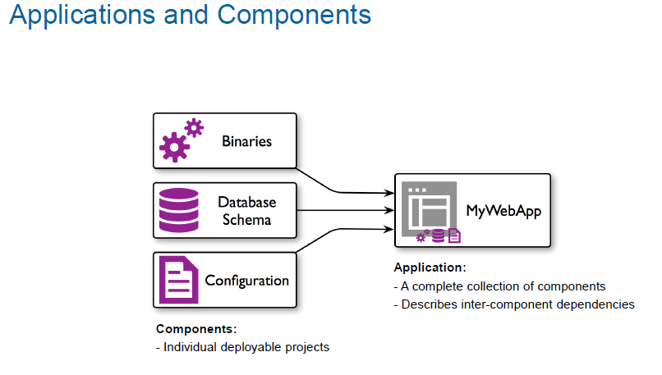

Slide 10
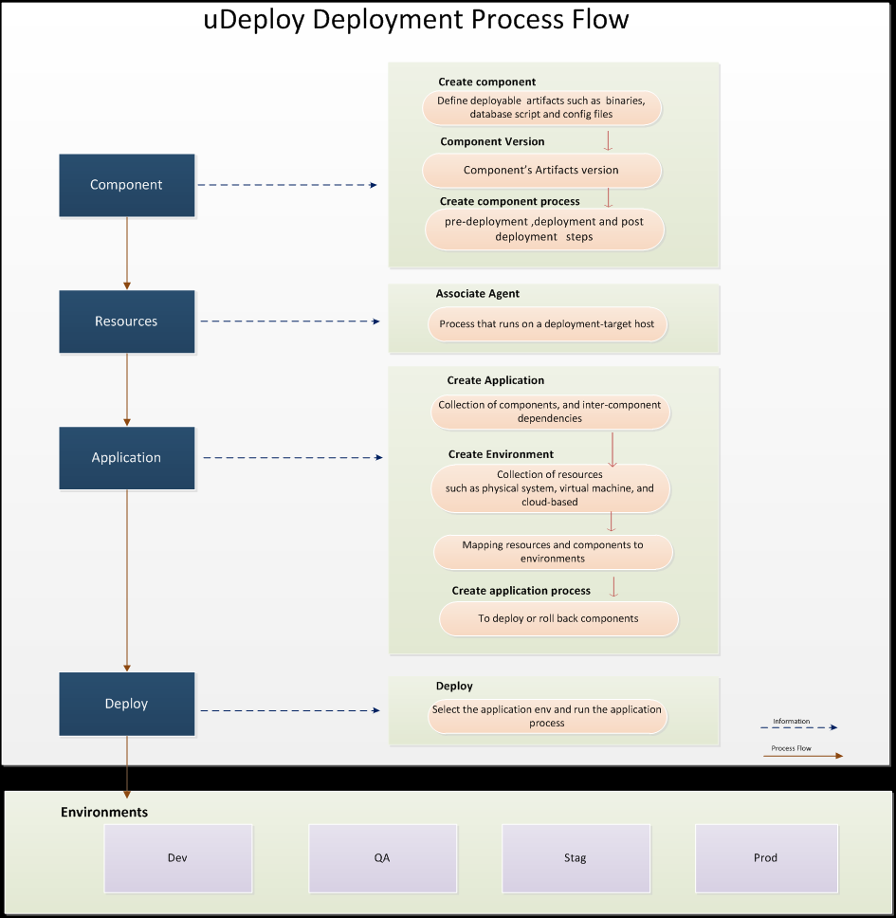
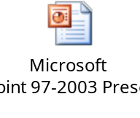
Modeling uDeploy Process Flow for B2B

Slide 11
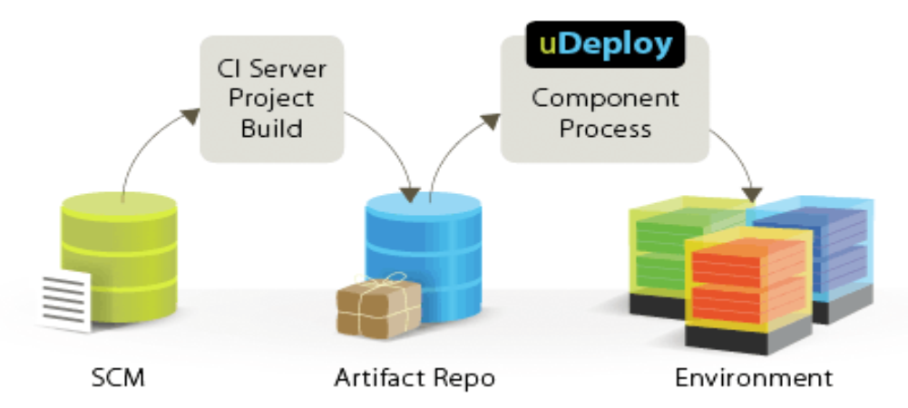
Process Flow

Slide 12
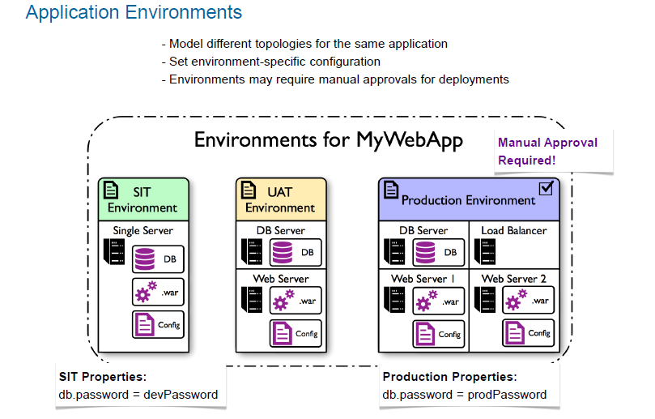

Slide 13
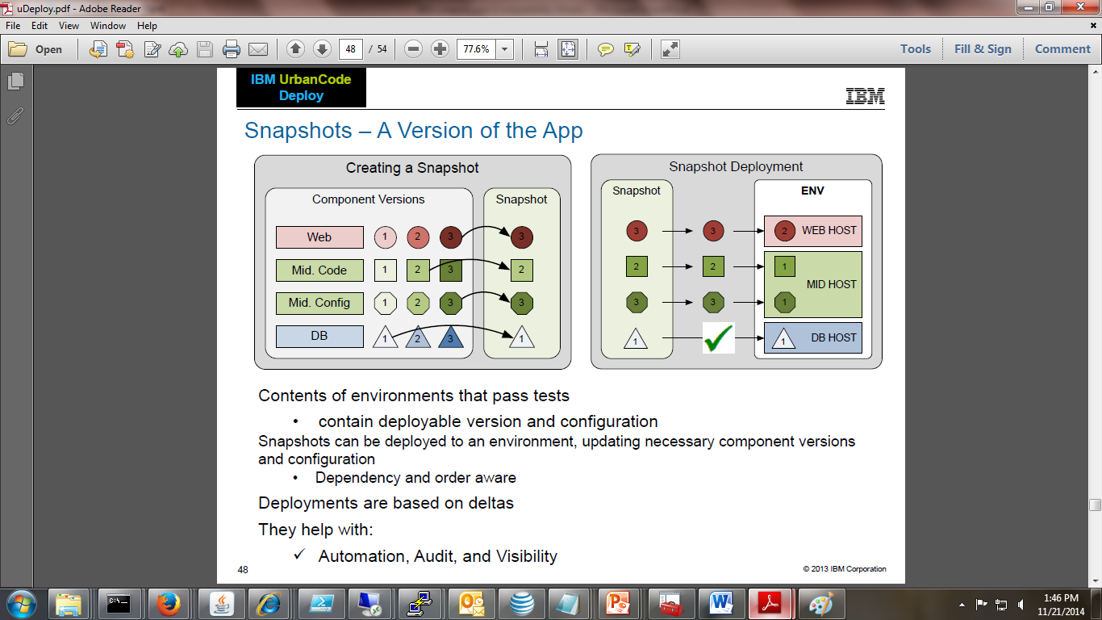

Slide 14
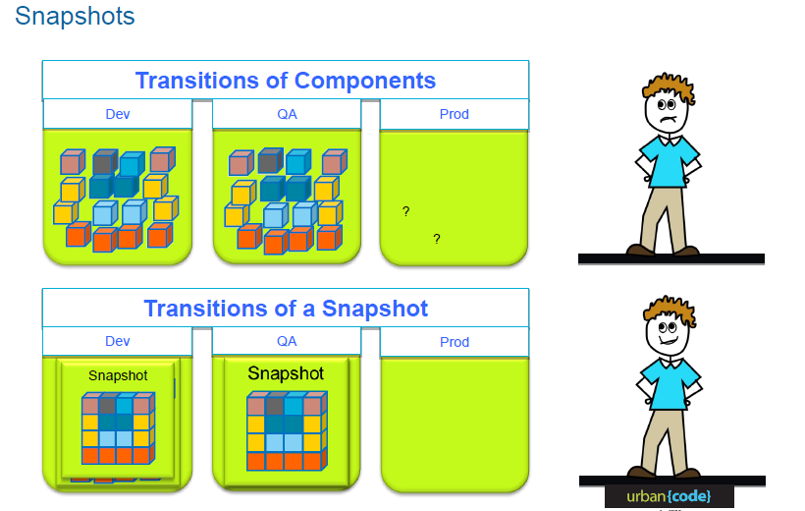
Snapshots

Slide 15
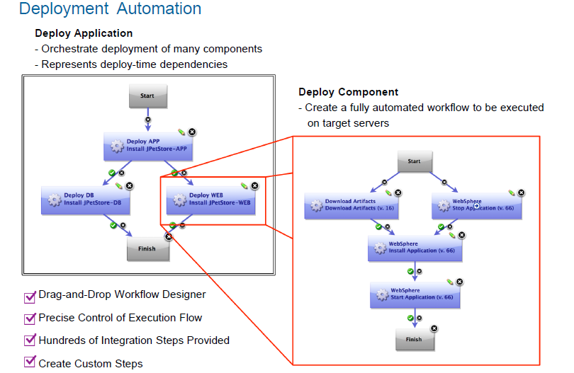

Slide 16

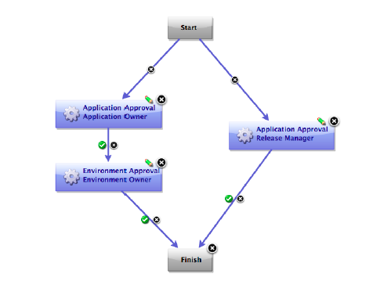

Slide 17
Deployment of a war file to a tomcat server using UrbanCode Deploy

Slide 18
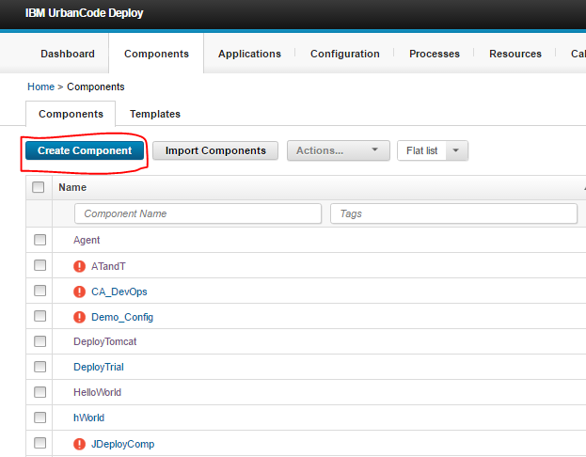
Create a Component

Slide 19
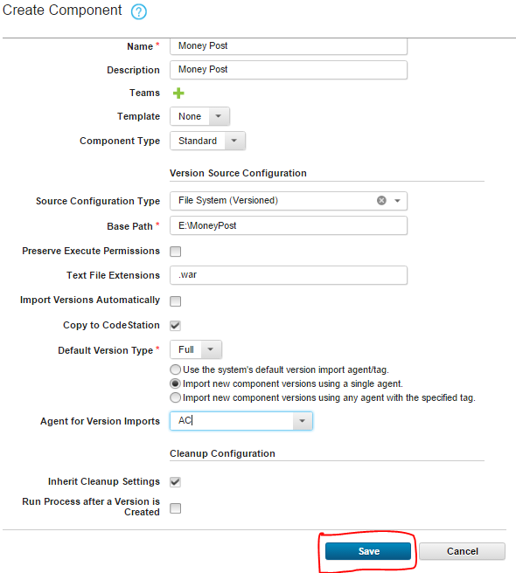

Slide 20
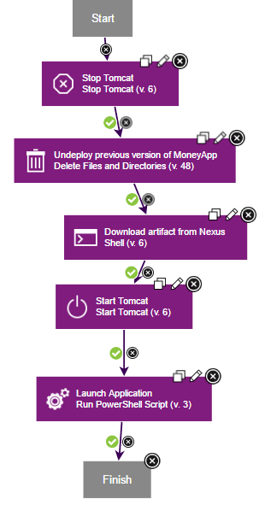
Create a Component Process

Slide 21
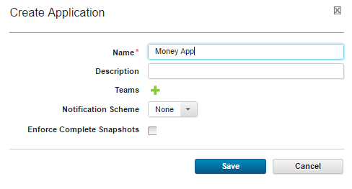
Create an Application

Slide 22
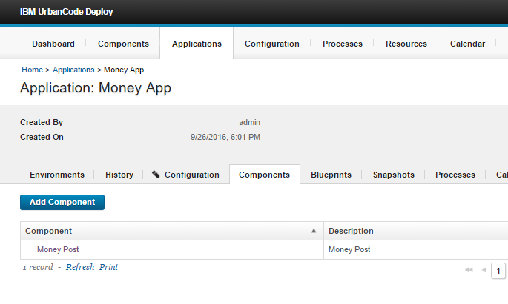
Add the components to Application

Slide 23
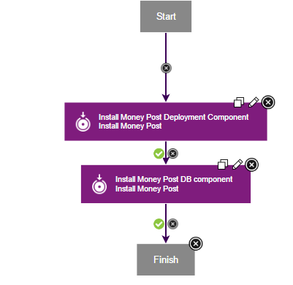
Create an Application Process

Slide 24
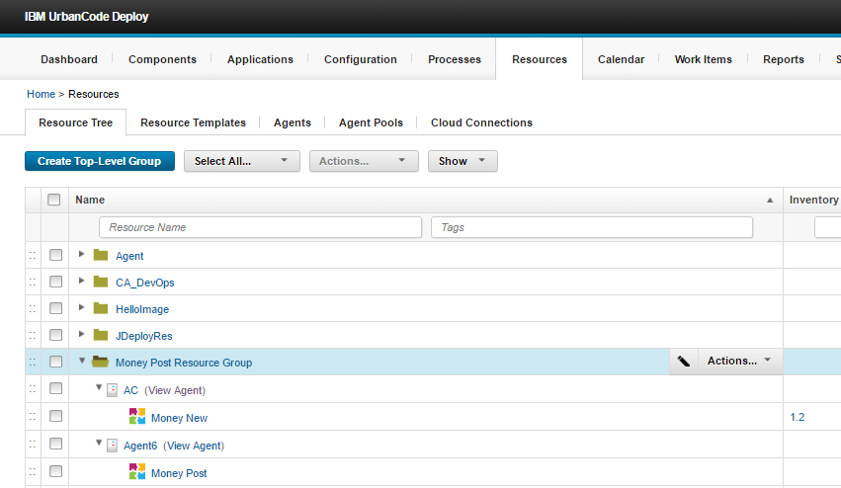
Create a Top Level Group

Slide 25
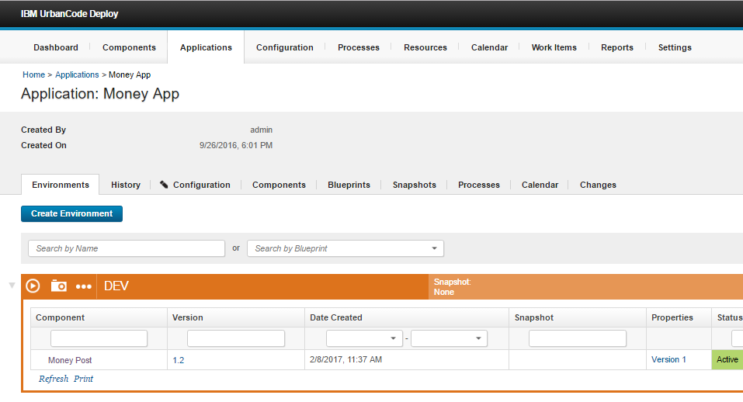
Create an Environment

Slide 26
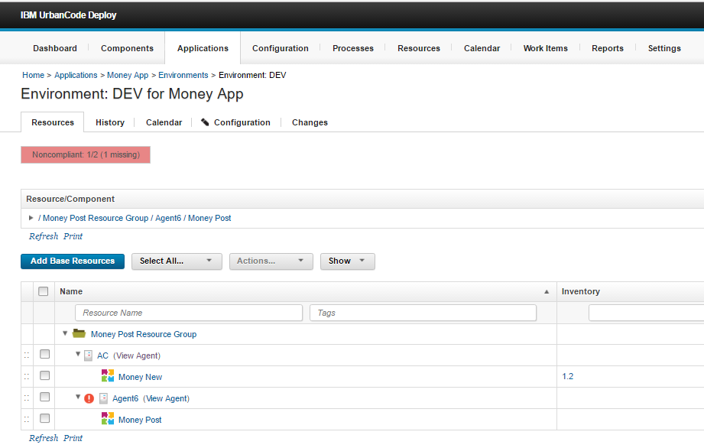
Add the resource group to environment

Slide 27
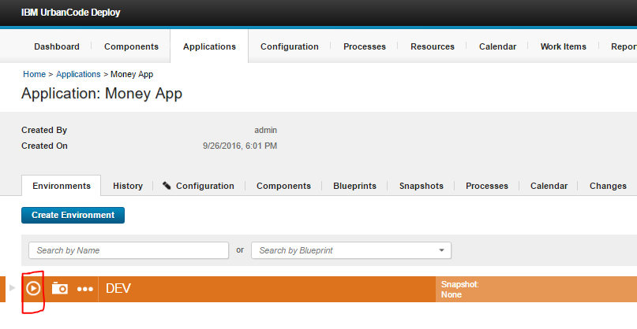
Start Deployment

Slide 28
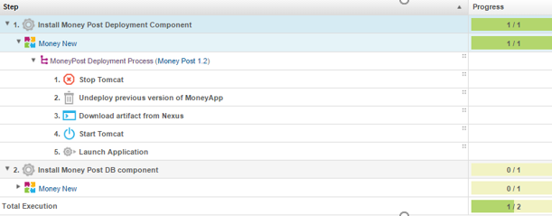
Deployment status

Slide 29
UrbanCode Release
IBM UrbanCode Release is an intelligent collaboration release management solution that replaces error-prone manual spreadsheets and streamlines release activities for application and infrastructure changes.

Slide 30
Typical Uses
Identify Release Dependencies: From initial planning through discovery in testing, easily identify and track release dependencies across applications and infrastructure.
Release Planning and Tracking: Map applications, changes, and initiatives to releases, and track the completion of Application changes and attainment of quality certifications for applications in a release.
Easier Release Days: Build an executable deployment plan that seamlessly notifies team members of work to do, and triggers automated tasks while providing up-to-date status that everyone can see.
Handle More Releases: Accommodate a growing number of release using more templates, automatic rules, and visibility that mitigates risk.
Multi-Application Continuous Delivery: Rules for automatic promotion across groups of applications enables applications to take advantage of continuous delivery techniques.

Slide 31
Key Offerings
Multi-Application Continuous Delivery
Urban Code Release allows you to easy capture these relationships and plan releases spanning multiple applications and setup automatic promotion rules to speed changes through the pipeline.
Impact Analysis
See which other applications may be impacted by an application that has fallen behind with incomplete features, or troubled test results.
Release Pipeline Visualization
From the Pipeline, we can also schedule deployments and see when the
next deployment to each environment is planned. It is also clear when the
previous deployment occurred.
Release Gates
Urban Code Release has Statuses which serve to identify quality certifications
achieved by deployable versions.

Slide 32
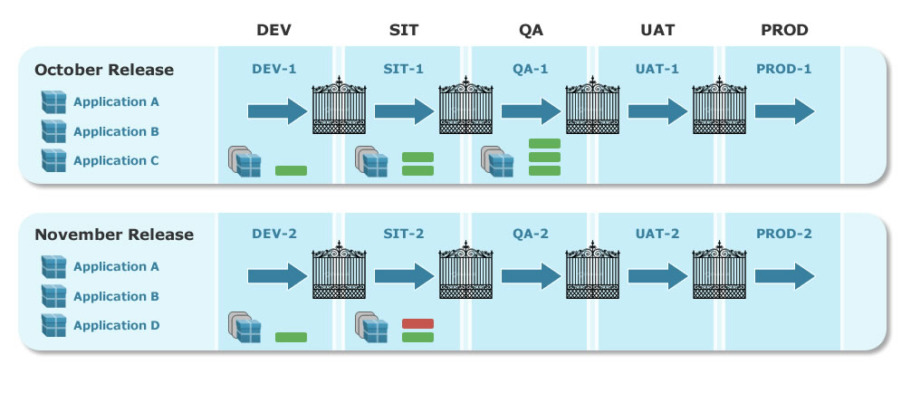
Release Planning
The figure illustrates two releases, October and November, that use the same lifecycle model. The phases that are defined in the model are listed across the top. Environments are allocated to releases and each phase is assigned one, which is shown in the illustration. The October Release, for example, uses the DEV-1 environment during the DEV phase, while the November Release uses DEV-2 for that phase. The gates between phases are defined in the model

Slide 33
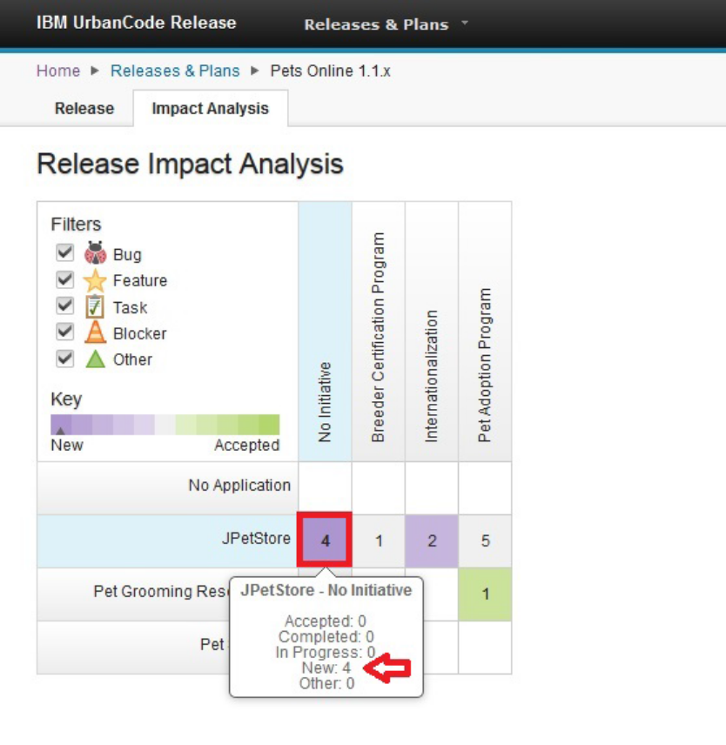
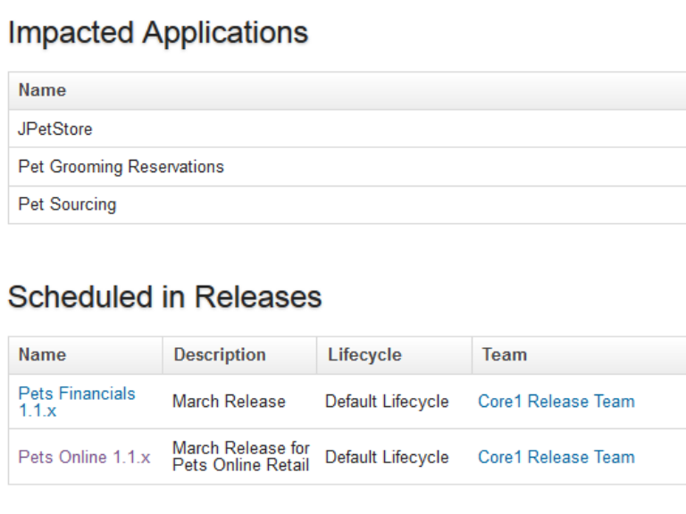
Track your changes and dependencies in the context of a release.
Detect what application is at risk
Integrate with Rational Team Concert
Risk Management – Impact Analysis

Slide 34
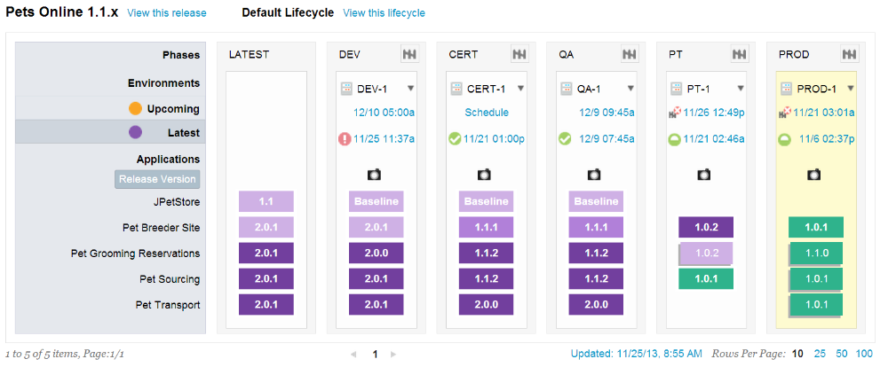
Keep track of the inventory across the entire life cycle of the release.
Control the entire release lifecycle in an easy to use view.
Increased Visibility and Control
Pipeline View

Slide 35
Thank you
Visit us at www.techmahindra.com

